Slide 1
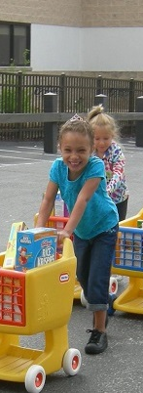
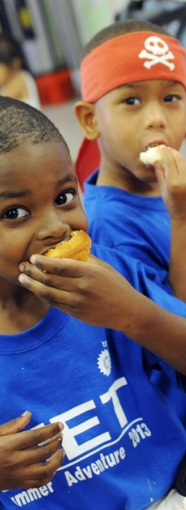
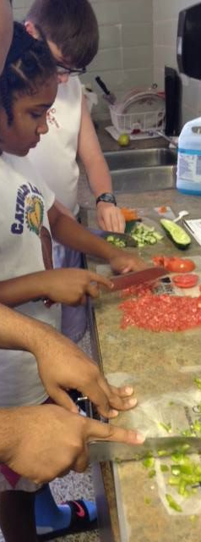
2017 CHILD HUNGER SUMMIT
Kimberly Krupa • March 2, 2017
Notes:
Main themes: innovative approaches to ending child hunger. Real case studies that everyone can do. Touch on fundraising and building community support, including volunteer army. Emphasize it takes a village. Rural areas and hybrid programs.

Slide 2
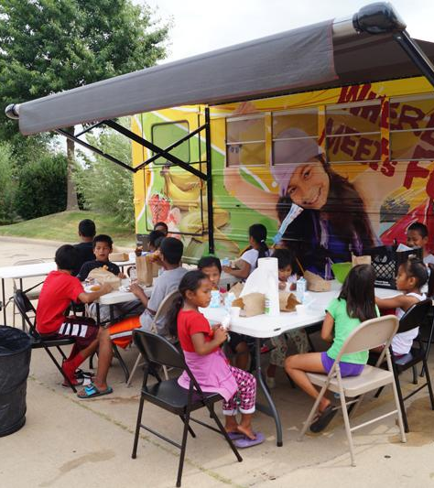
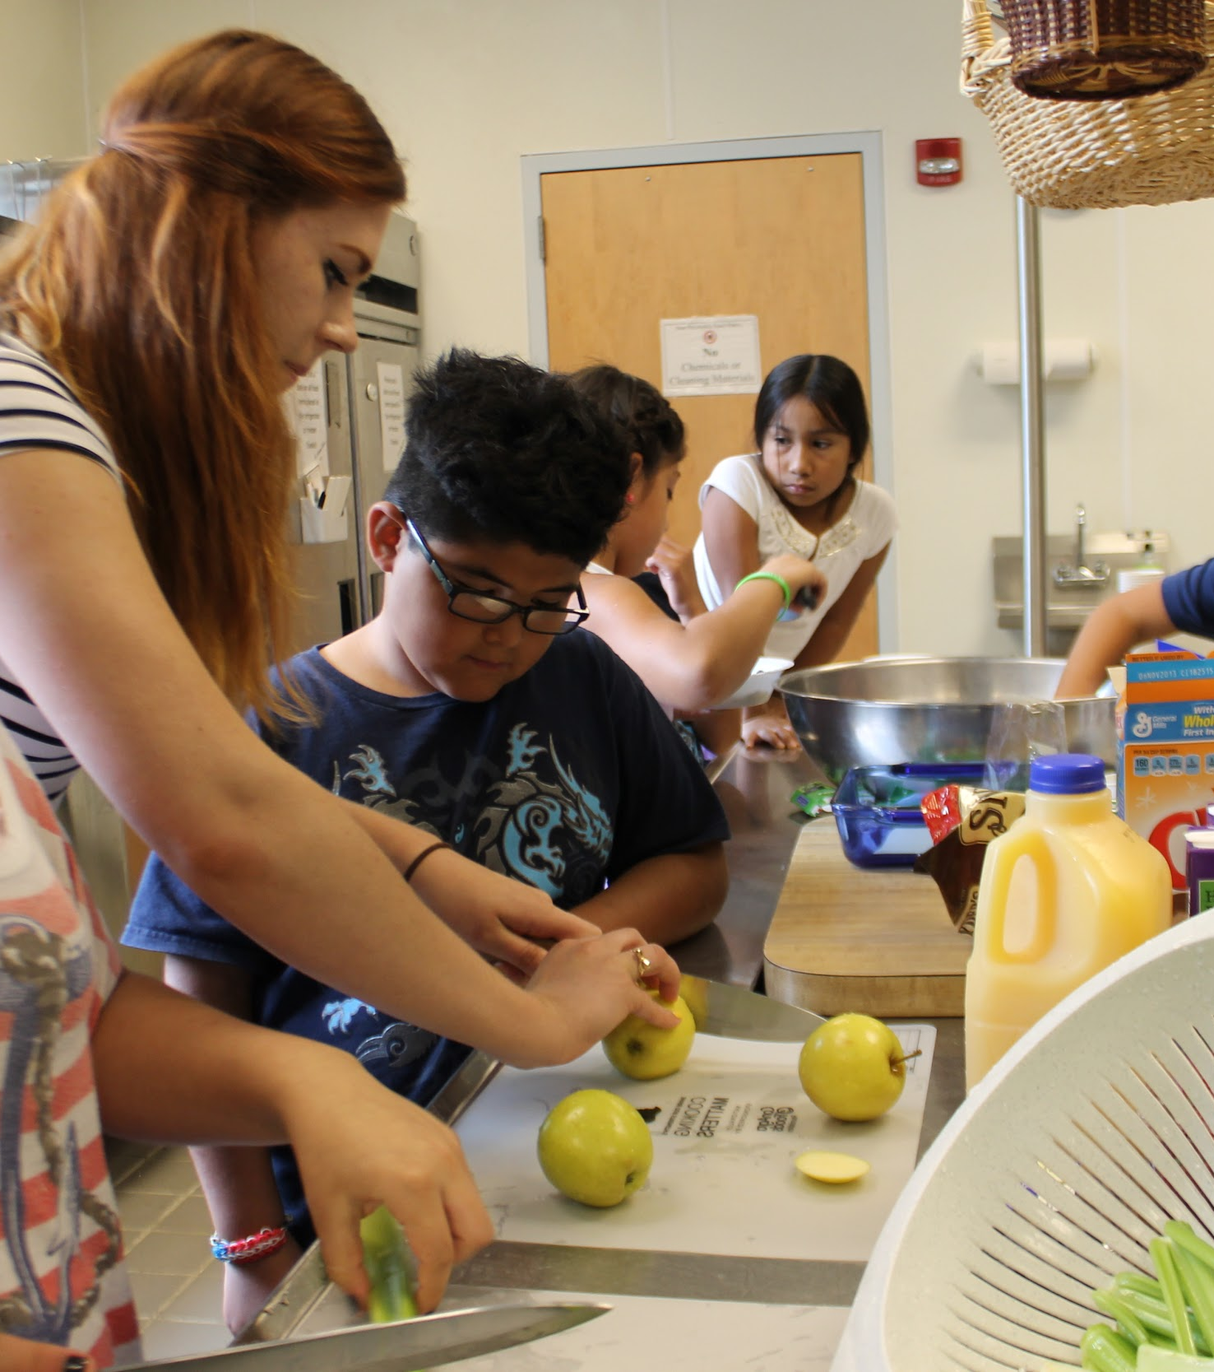
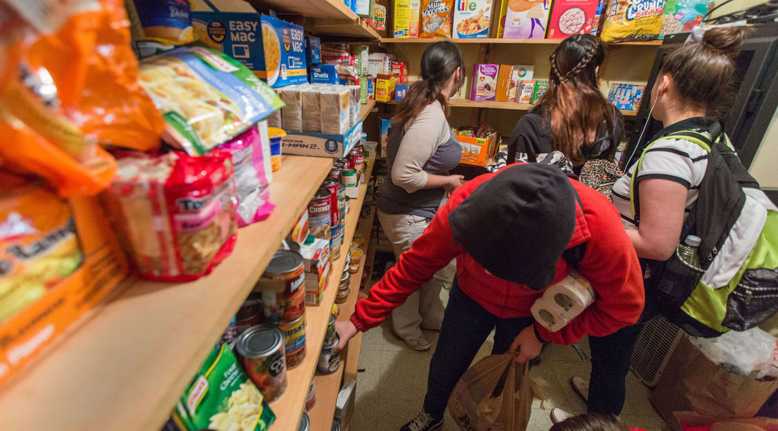
How can we end child hunger in our communities?
Innovative, everyday approaches you can start TODAY.
Notes:
The central question we’re going to answer this morning: How can we end hunger in our communities?
There’s no one way. There’s no best way.
Each community finds success when they create their own unique way. ———CLICK—-
We’re going to learn about those innovative, everyday approaches and talk about things you can start doing TODAY to feed hungry kids and families. And here are just a few ideas I’ve collected to start us off:
*Kids eating lunch at one of the Arkansas summer feeding bus stop
*Free children’s cooking class using food pantry ingredients: New Orleans, Louisiana
*High school students shopping at their school pantry in Lafayette, Louisiana

Slide 3
Real people.
Real stories.
Be inspired.
Notes:
Real people. real stories.
These are all true stories and real pictures either taken by me or a food bank
colleague. Everything you’re about to hear is re
Some housekeeping: I will be here all morning, so if you have questions, write it
down and let’s talk about it during one of our breaks or during lunch. I’ll stay as long as I need to today to make sure you have what you need to ————— —————CLICK—be inspired.
On our journey today we’re going to walk through three amazing programs - Backpack, School Pantry and Summer Feeding, - and then talk about new ways you can feed hungry kids and families through your existing programs. We will end with my top 10 tips on getting started TODAY in your own community.
First, the Backpack Program ...

Slide 4
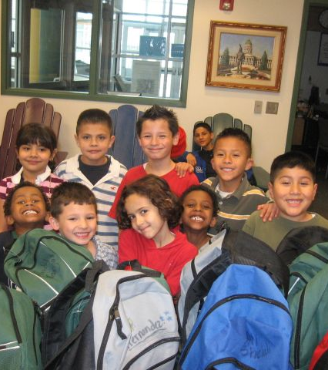
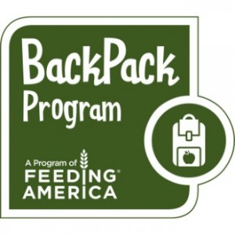
Backpack Program
New ways to feed hungry kids when they need it most
Notes:
More than 22 million children receive free or reduced-price meals through the National School Lunch Program and the National School Breakfast Program
What happens when they go home over the weekend?
For more than 15 years, the Feeding America BackPack Program has been helping children get food to eat on the weekends.
Some quick stats: Today, bags of food are assembled at more than 160 local food banks and then distributed to more than 450,000 children at the end of the week through schools and partners like you.
How does this happen?

Slide 5
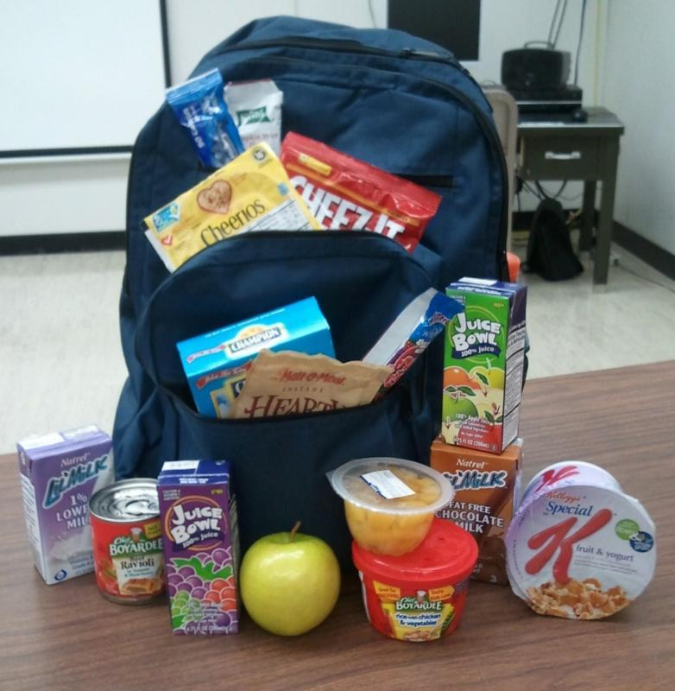
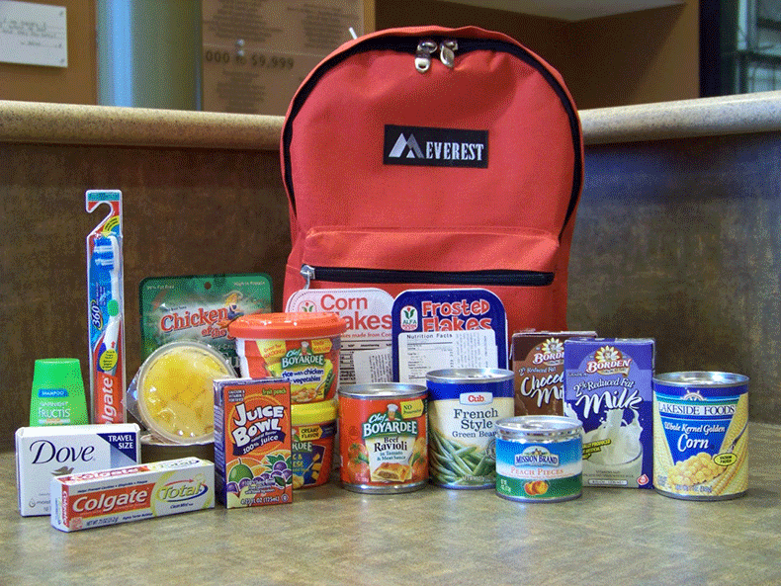

Notes:
Communities come together and literally ‘fill the backpack.’
None of this so far is rocket science, right?!
Look at these two pictures. The contents of a backpack are as varied as there are ways to run the program.
Packs generally contain 8-12 items of low-sugar, highly nutritious kid-friendly food plus shelf-stable milk or juice. Some packs have hygiene items, like the picture on the right. Others follow standard meal menus. Still others are assembled based on what’s on hand at a given food bank or food pantry’s shelves.

Slide 6
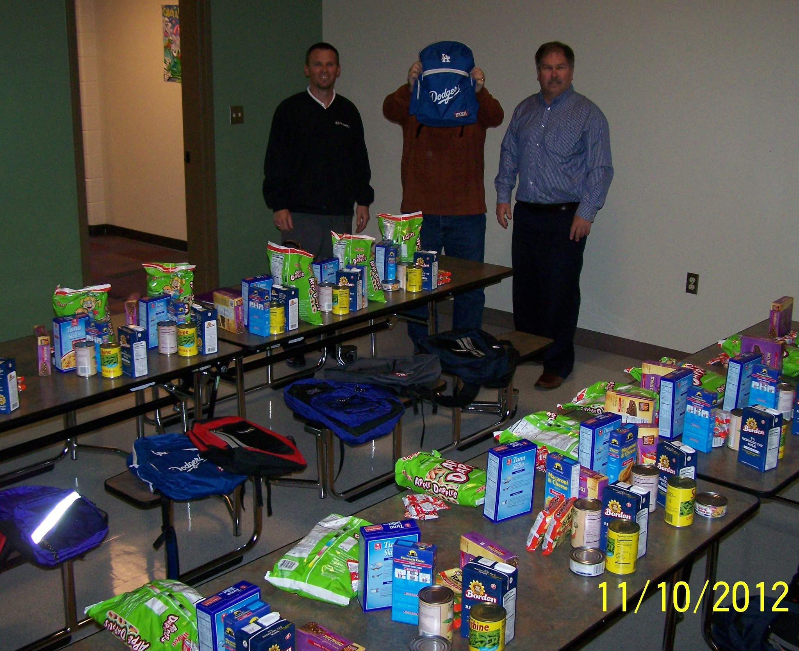
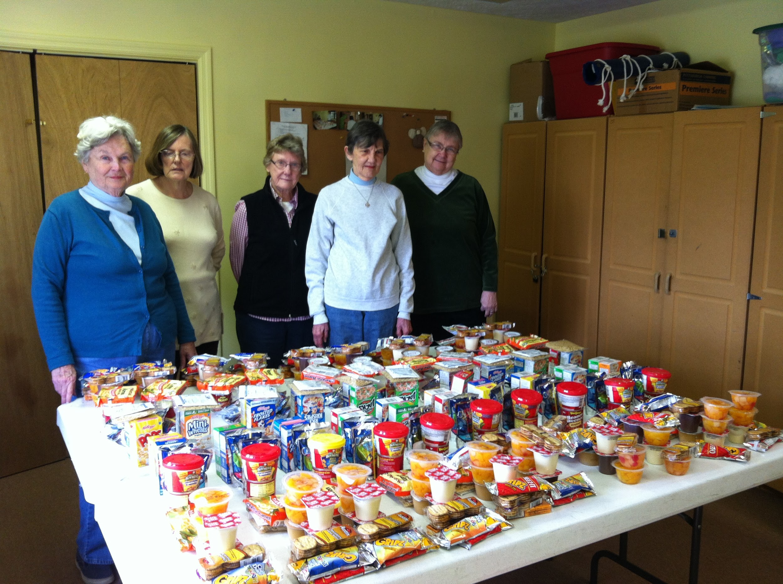
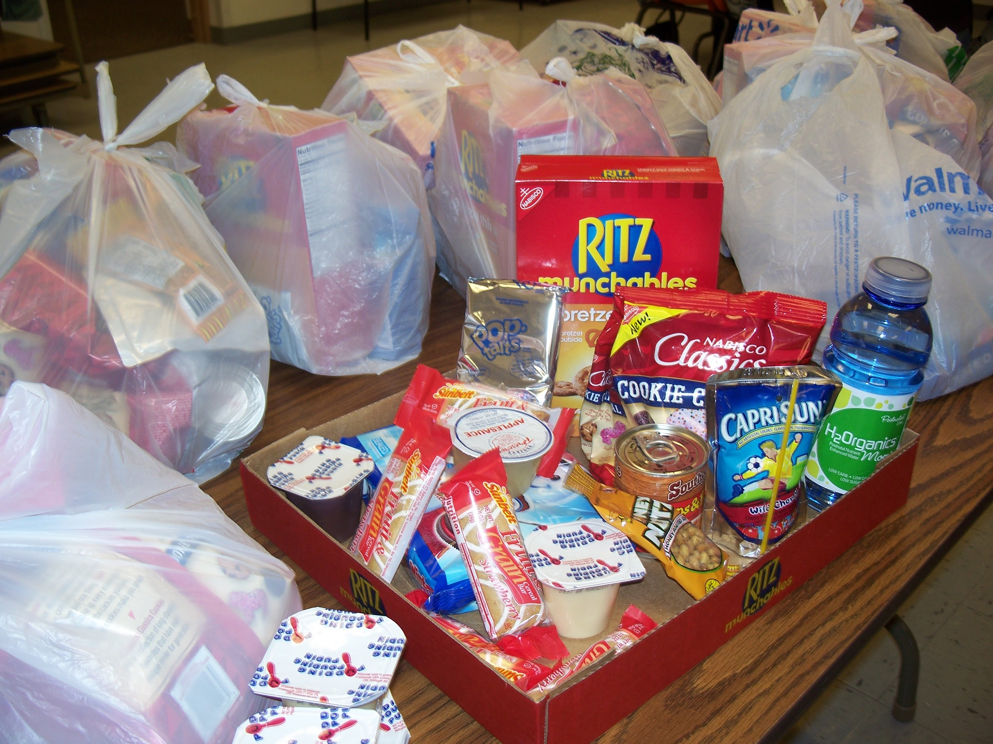
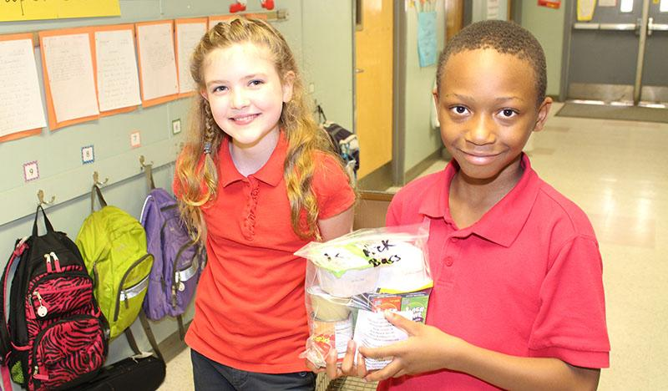
Backpack Approaches
Notes:
What you see in these backpack approaches is communities coming together to feed hungry kids when they need it most.
Who packs the bags? Organizations and volunteers who have relationships with each other.
Where does the food come from? Anywhere and everywhere
How does it get to the school? Again, relationships with churches, school principals, classroom teachers, even the students themselves as they learn there is no shame in having something to eat.
One community that taught itself how to run a successful Backpack Program is Trinity Lutheran Church in Gaston County, North Carolina, in partnership with the local food bank, Second Harvest Food Bank of Metrolina, which covers metro Charlotte.
Let’s learn how they did it.

Slide 7

Case Study 1: Gaston County, North Carolina
Notes:
Case Study: Recent 5-minute video of Holy Trinity Lutheran Church’s efforts to start the Backpack Weekend Food Program. The BWFP provides children in need with a plastic bag of nonperishable, individually-portioned, nutritionally-balanced food to take home in their backpacks on the weekend when school meals are not available. Those students most likely to be hungry on the weekend are identified by school counselors, social workers, teachers, school nurses, and principals. Permission to participate in the program must be given by the child’s parent or guardian and any allergies are identified.

Slide 8
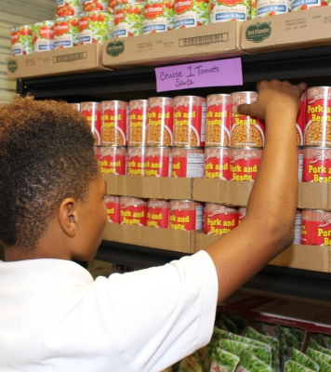

School Pantry Program
New ways to feed hungry kids and families at the safest place imaginable
Notes:
School Pantry extends the impact of the Backpack program to feed the whole family.
A School Pantry is quite literally a food pantry inside a school.
They tend to have set distribution schedules and offer ongoing food assistance services, like access to school guidance counselors and social workers who can screen for other safety net programs.
School Pantries may have a permanent set up within a school or may operate through a mobile distribution rotation that brings food to a school campus.
Nationally, the School Pantry program serves more than 21 million meals to nearly 110,000 children.

Slide 9
Case Study 2: Love Pantry of Central Florida
Notes:
One community that’s doing School Pantry really well ALSO has a fantastic name: The Love Pantry!!
A friend of mine at Second Harvest in Central Florida told me about this program just last month. The Love Pantry is a project of the Christian Service Center for Central Florida and it provides struggling families with emergency food distributed through a group of elementary schools.
Let’s watch how they do it

Slide 10
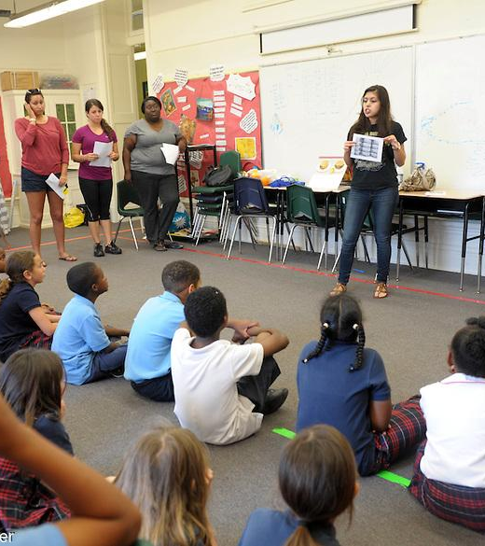
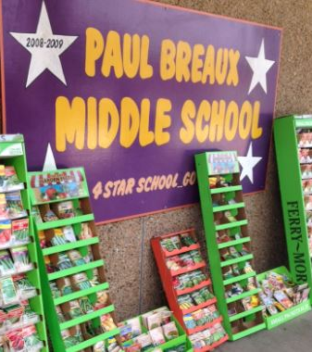
Case Study 3: Paul Breaux School Pantry, Louisiana
Notes:
Nutrition education, gardening - incorporating innovative root causes work into school pantry setting

Slide 11
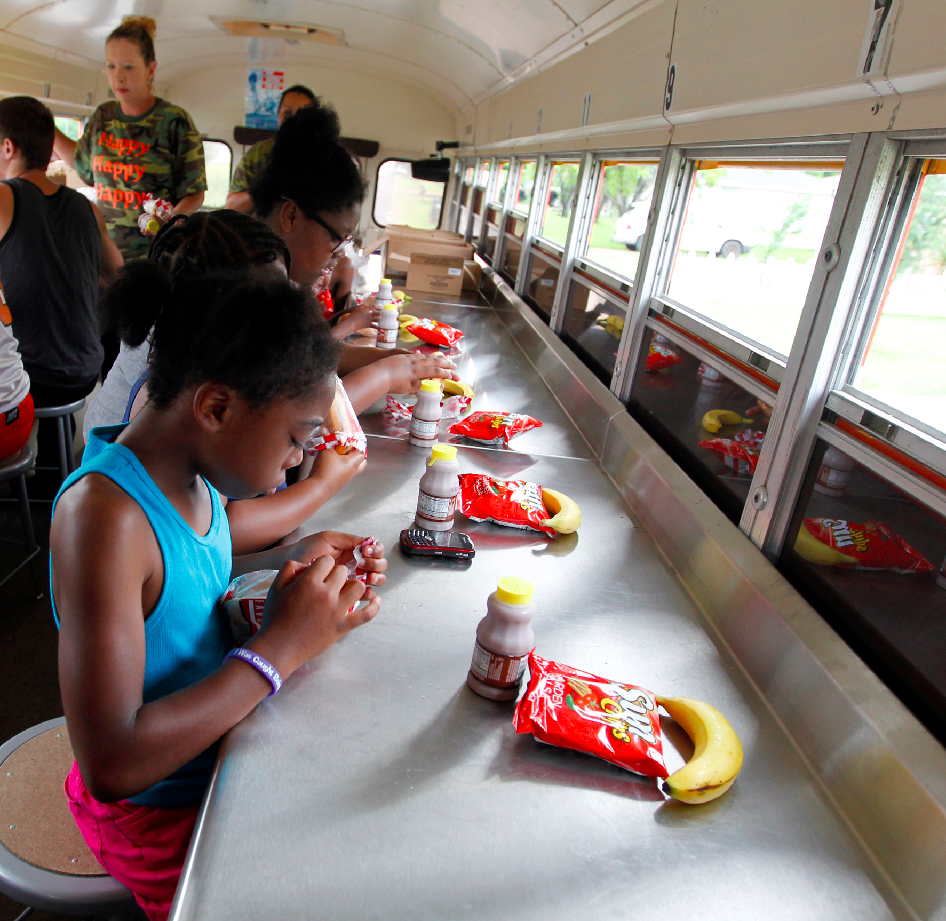



Summer Feeding Program
New ways to close
the summer meal gap
Notes:
You remember that 22 million number? Well, only 3.9 million of them receive summer meals. That’s a gap of 1 in 6. Why is it so high?!
We need more relationships to help eliminate barriers. Look at this picture and think of all the barriers this Texas lunch bus is tackling. Transportation. Access. Awareness. Safety and climate control.
The beauty of summer feeding is that there’s NO ONE WAY TO DO IT. The program has built-in flexibility that allows partners to do things like THIS:

Slide 12
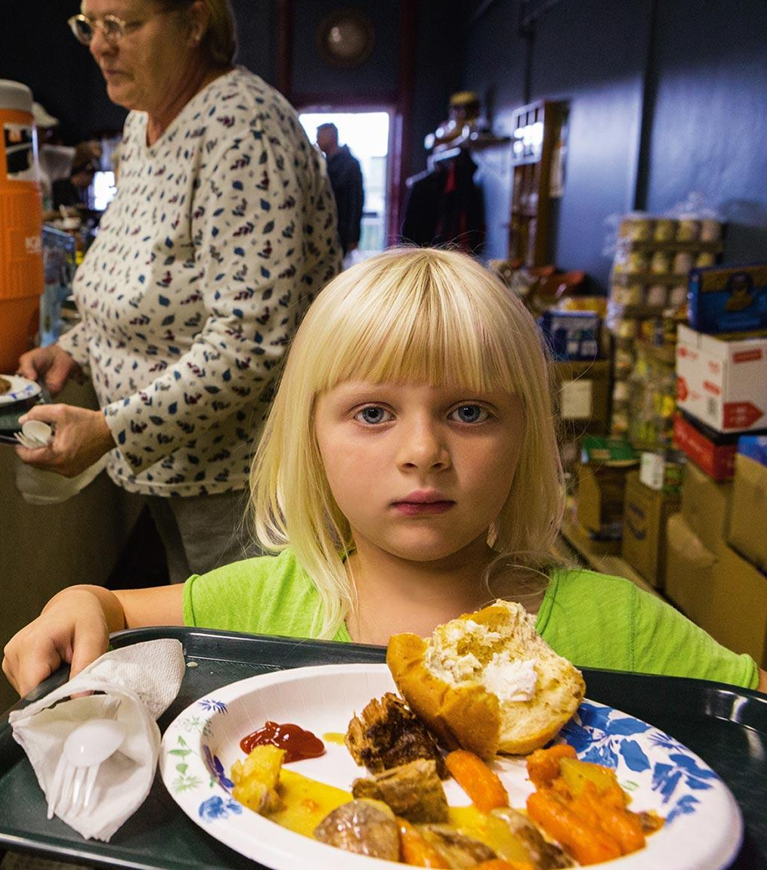
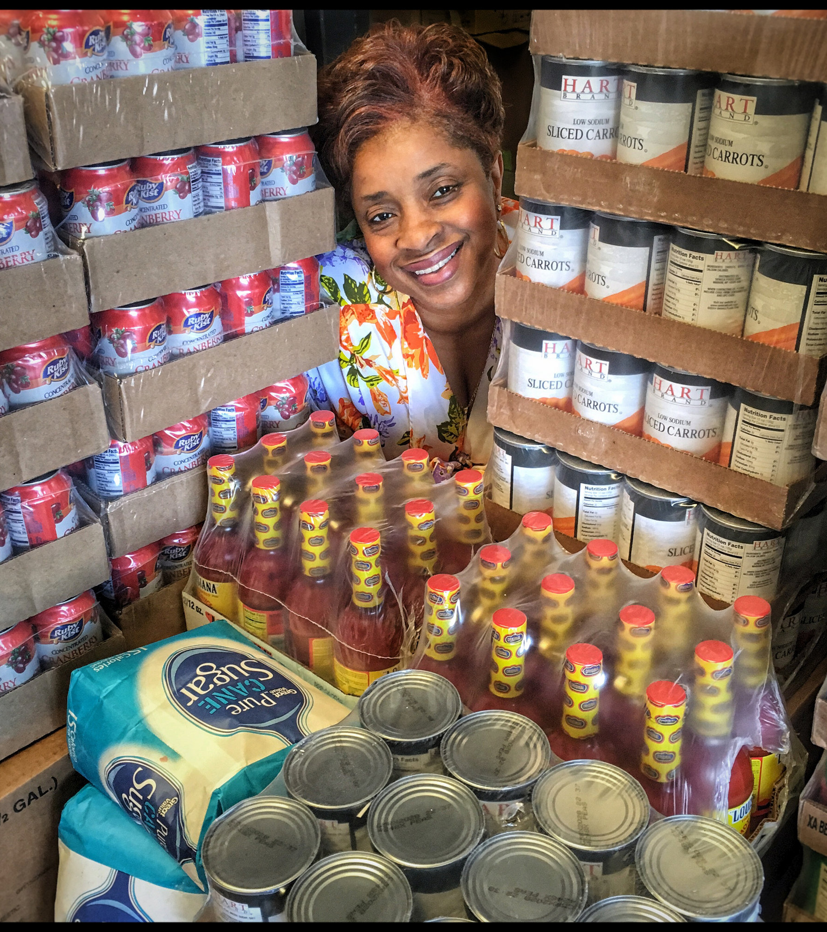
Case Study 4: Summer Feeding at HOPE The Food Pantry
Notes:
Feed kids in your food pantry!
In this case study, you are looking at what’s called an “open” summer feeding site that NOT ONLY meets all USDA food safety requirements, but shows us that WHERE THERE’s A WILL THERE’s A WAY.
If your food pantry has a kitchen, you can throw open your doors to feed kids this summer. Just ask Betty
- CLICK -
one of my heroes who had this vision. We worked together to make it happen. Her volunteers create the menu, cook and recruit the kids. We just provide the support. WHERE THERE’s A WILL, THERE’s A WAY.

Slide 13
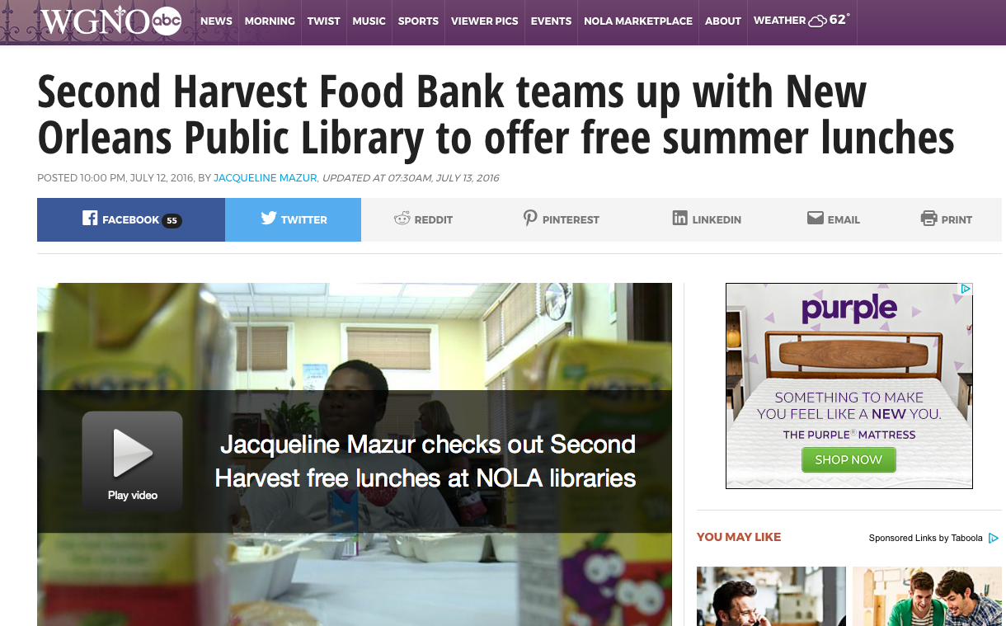
Case Study 5: Lunch at the Library
Notes:
One of the Summer Feeding barriers is understanding where kids go in the summer. In Louisiana, it’s so hot outside that many kids spend their days unsupervised at the public library. Summer Feeding is flexible enough to allow kids to be fed almost anywhere.
Let’s learn about how Lunch at the Library works.

Slide 14
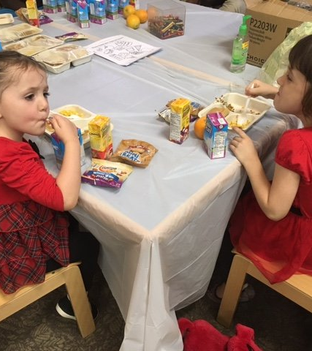
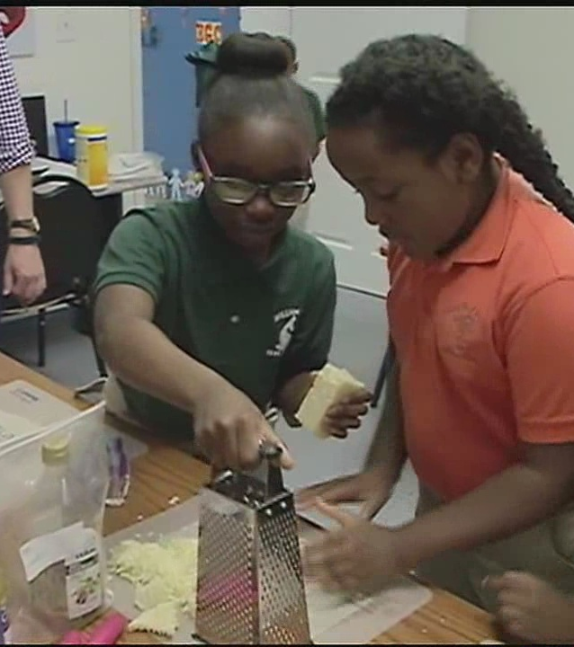
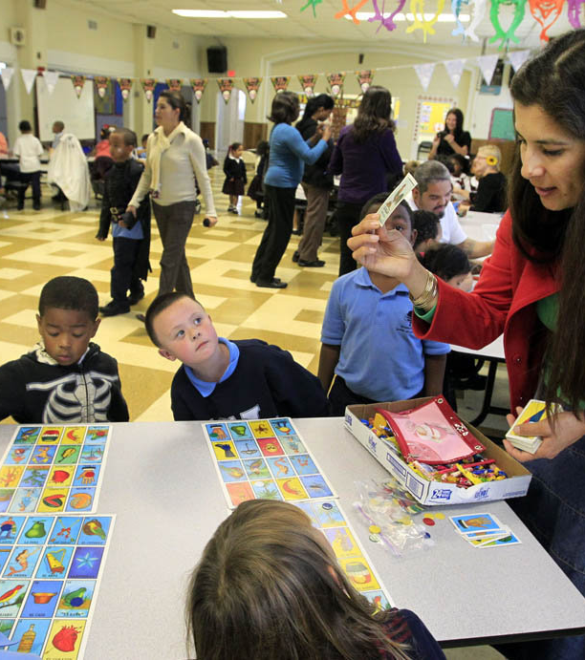
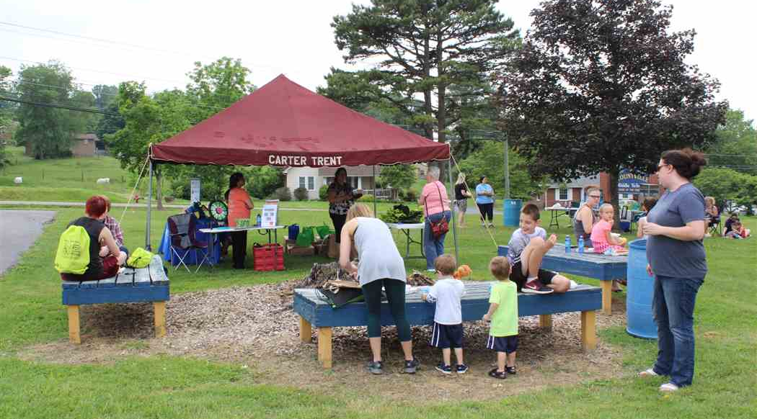
Notes:
Other Summer Feeding approaches: examples from left, pediatric waiting room, Summer Feeding and nutrition education, myplate bingo nutrition activity, public park open site combines fitness and food

Slide 15
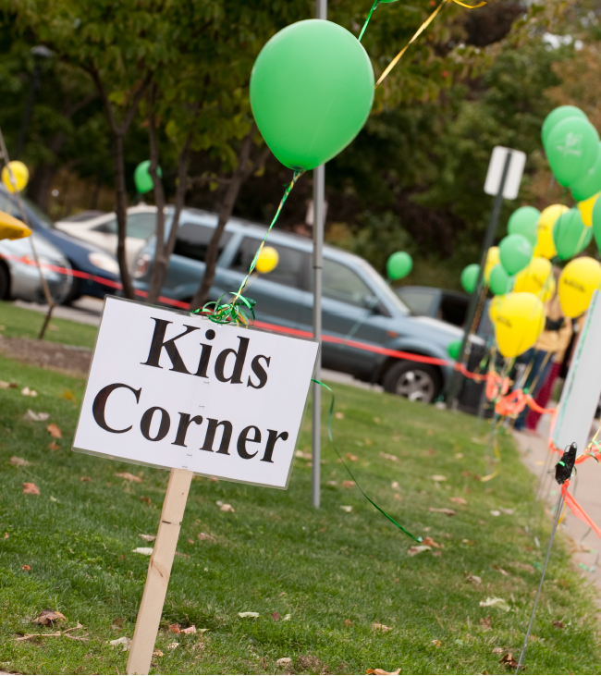
Hybrid Child Hunger Programs
New ways to feed
kids and families
through your existing programs
Notes:
Weaving nutrition, fitness, health access and family-friendly tools into existing food distributions

Slide 16
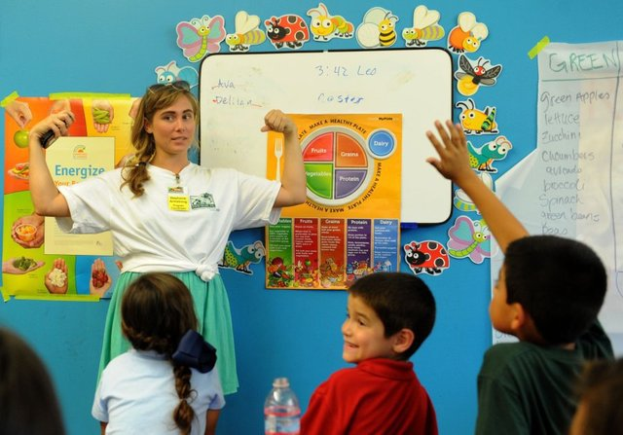
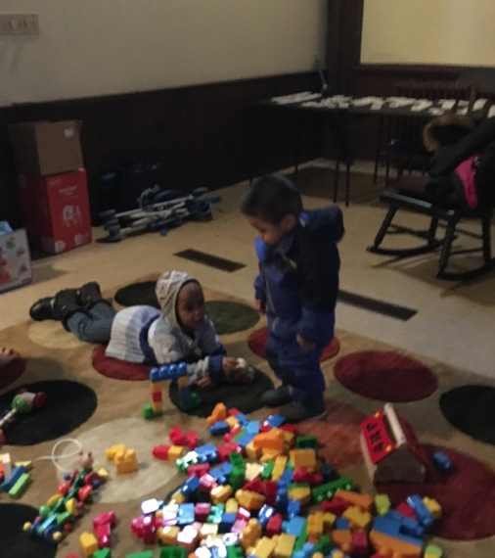
Case Study 6: Kids Corners
Notes:
Quick, cheap ways to create attractive settings for families in food pantries. Nutrition games in the food pantry setting while parents shop or pickup prepacked bags; toy library at the food pantry; other ideas are reading corners, book lending programs.

Slide 17
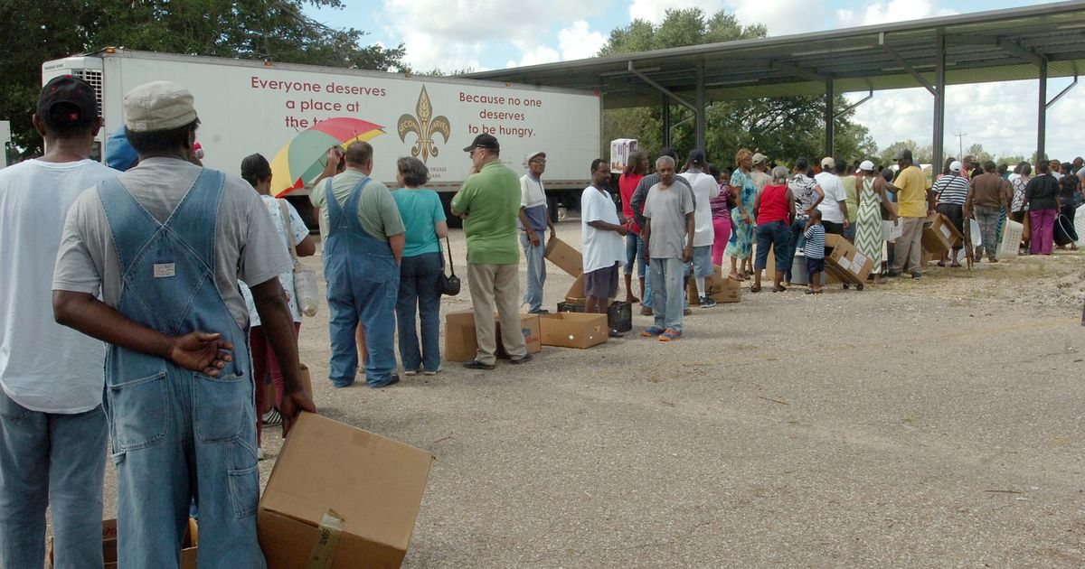
before
Case Study 7: Family-friendly Mobile Pantries
Notes:
Long lines, open to the elements, undignified, one-dimensional

Slide 18
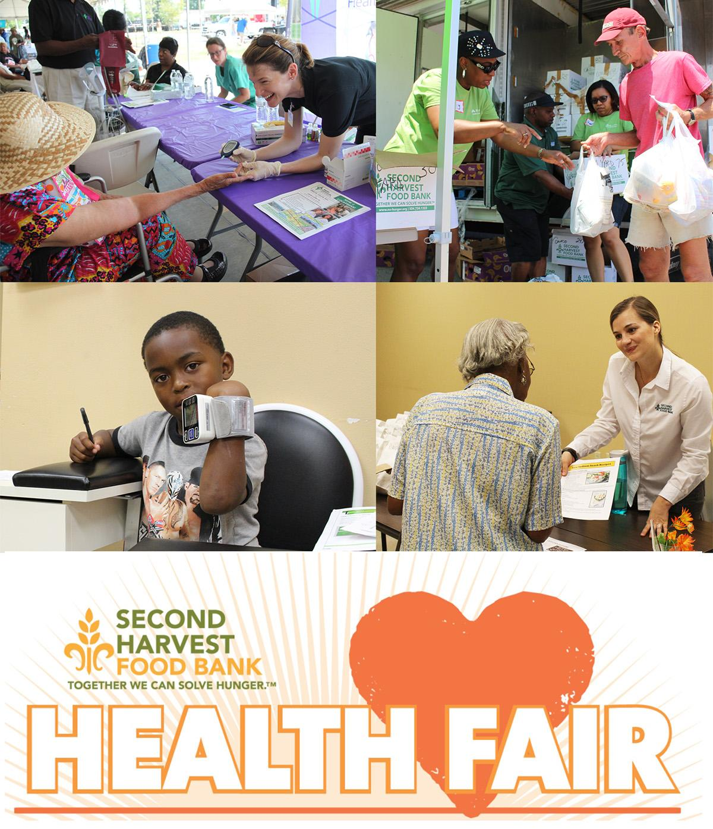
after
Notes:
After-food brings people together. Engage community volunteers, church leaders, educators, dietitians, social workers, and healthcare professionals. Food distributions as community events.

Slide 19
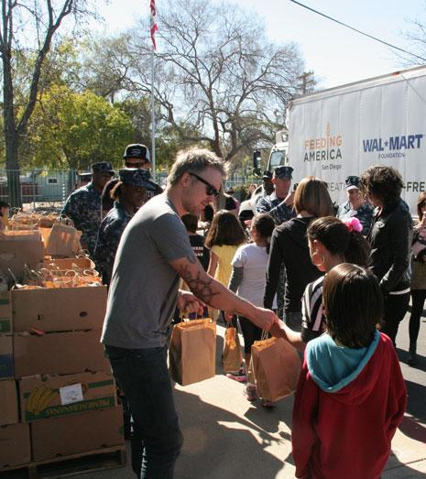
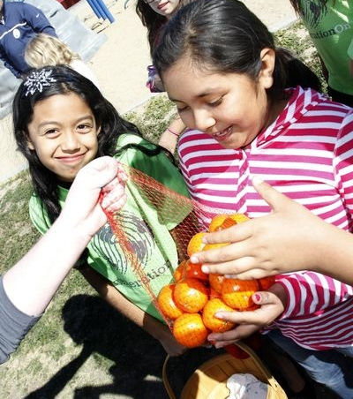
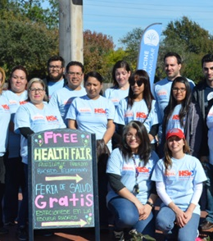
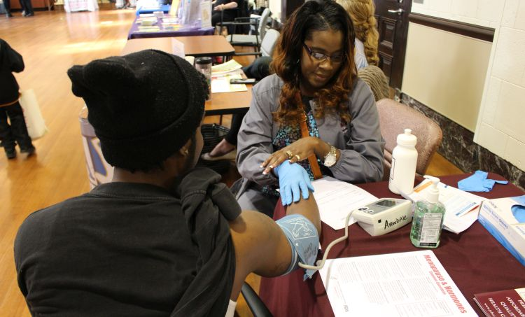
Notes:
Hybrid approaches: Kid sack while parents shop, produce and nutrition emphasis (recipes attached to certain produce items), Mobile Pantry distributions transformed into health events with screenings from local providers

Slide 20
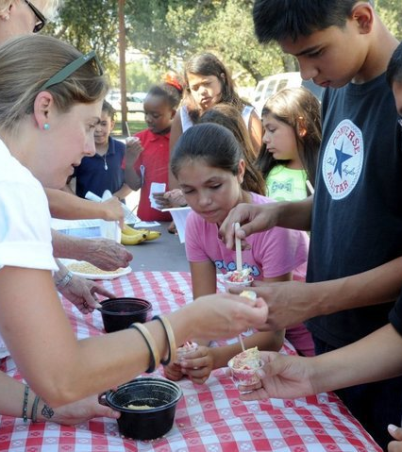
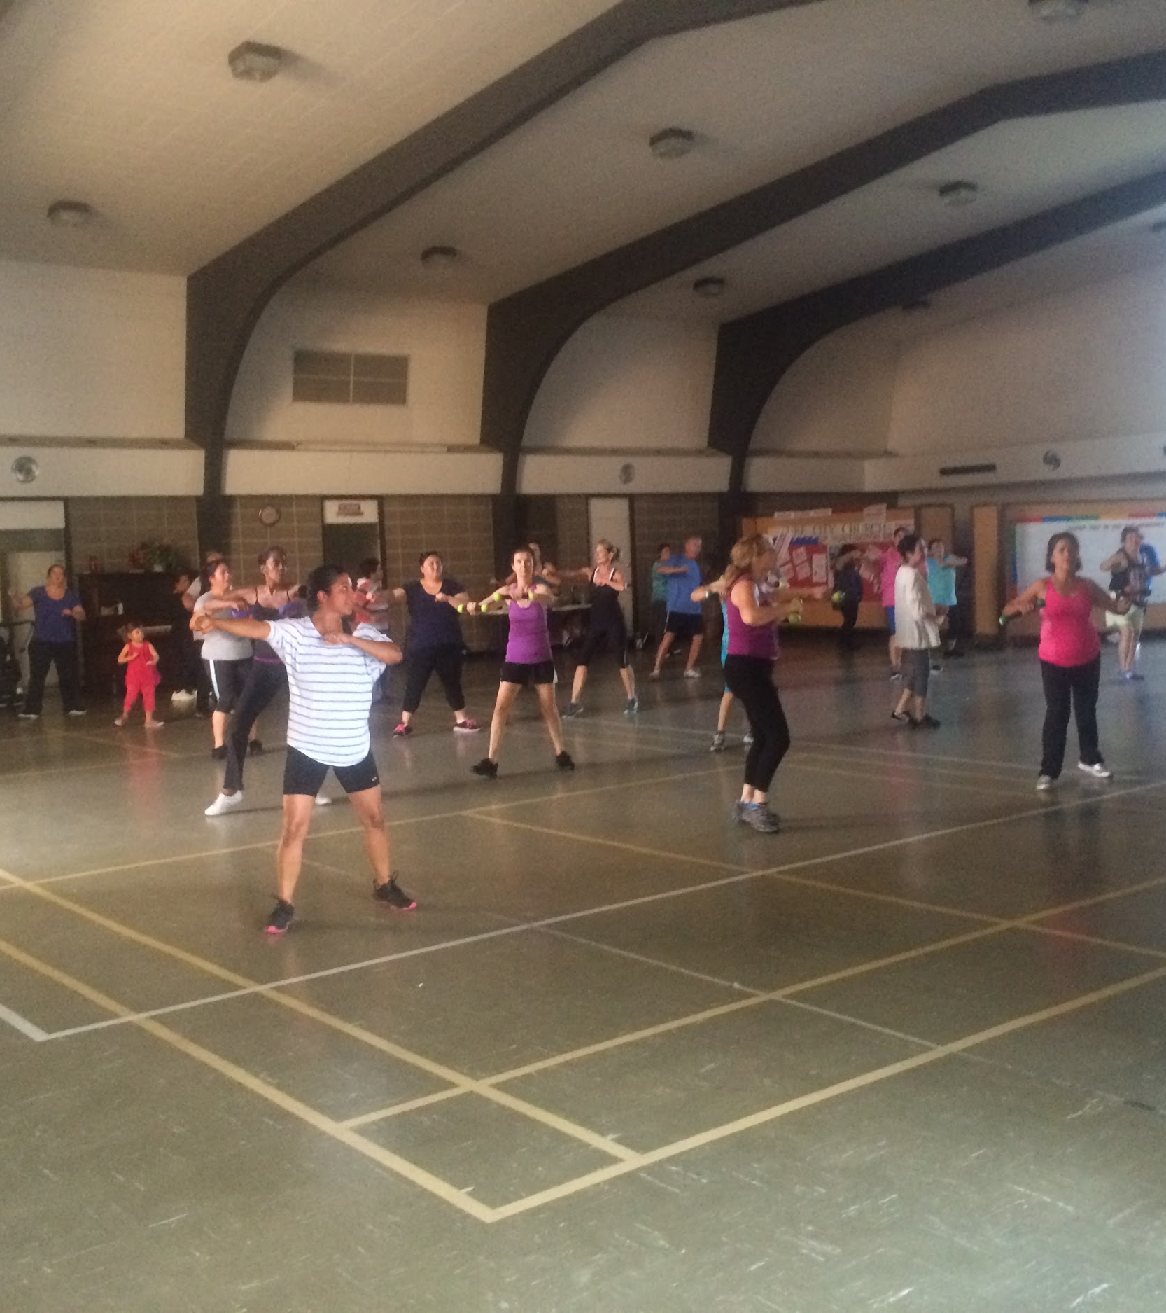
Case Study 8: Nutrition education, healthy food and ZUMBA!
Notes:
Parallel activities during food distributions keep kids and families engaged, shifting the emphasis from quantity/volume of food distributed and received to quality of experience, knowledge gained and lives changed.

Slide 21

Kim’s Top 10 Takeaways
Where there’s a will, there’s a way
Think big, start small
Don’t reinvent the wheel
Don’t get caught in the details
Be open
Manage expectations
Build an army
Ask everyone
Tell everyone
Say yes

Slide 22
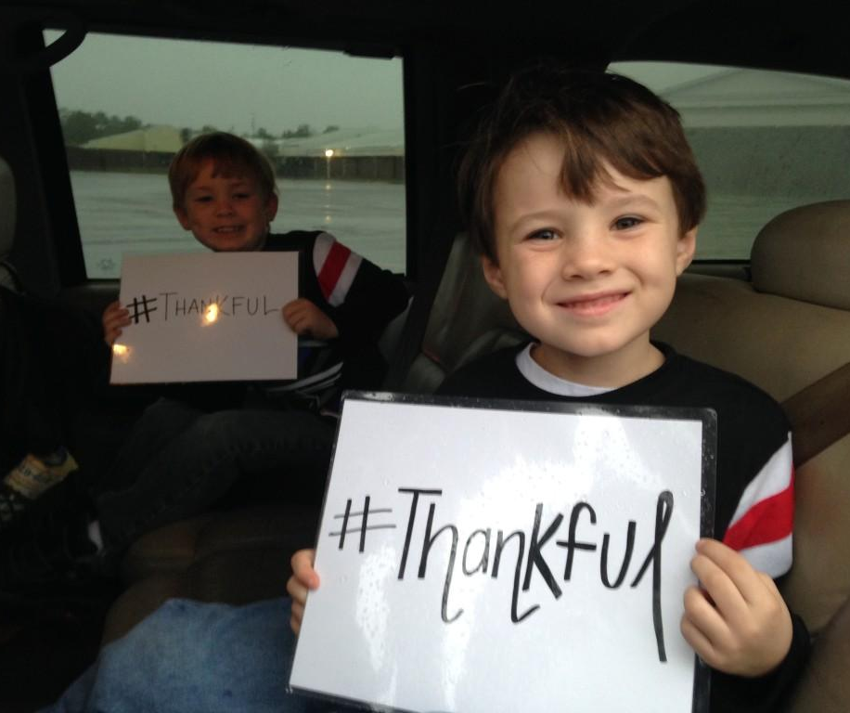
Thank you!
Contact:
Kimberly Krupa
kimberlykrupa@gmail.com
Notes:
Mention that I’ll be staying for the day and can answer questions individually

