Slide 1

Advocating for Alabama’s Children Since 1992
Advocacy Matters 101
March 2, 2017
Child Hunger Summit | Huntsville, AL
Rhonda Mann, Policy & Research Director
rmann@alavoices.org | 334-213-2410 x 103

Slide 2

Our Mission
To ensure the well-being of Alabama’s children through research, public
awareness and advocacy.

Slide 3
Our Goals Today
Define Advocacy
Basic understanding/review of Alabama’s Legislative Process
The role of the advocate and strategies
What makes your lawmaker tick

Slide 4
What is
Advocacy?

Slide 5
By definition advocacy
is the application of pressure and influence on the people and institutions that have the power to give you what you want.

Slide 6
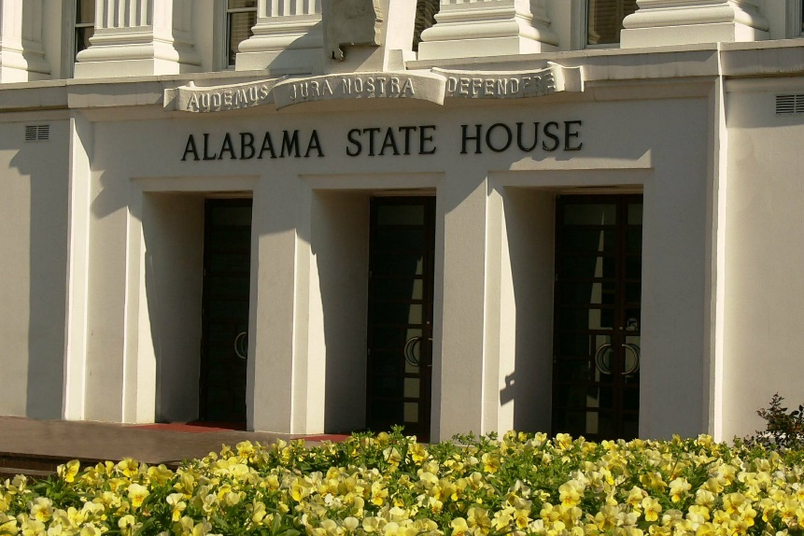
Alabama’s Legislative Process

Slide 7
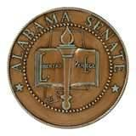

The Alabama Legislature
Senate | House of Representatives
Lt. Governor President Pro Tem | Speaker of the House Speaker Pro Tem
35 Members | 105 Members
*Serving in the legislature is a Part-Time position
*No term limits
*State-wide elections every 4 years

Slide 8
Alabama’s Legislative Session
  Limited to 30 legislative days within 105 calendar days
  Tuesday/Thursday are typically legislative meeting days
  Wednesday usually committee meetings
  Public Hearings
  Special sessions may be called by the Governor

Slide 9
Legislative Committees
  Divides up work at the Legislature
  24 Committees in the Senate
  31 Committees in the House of Representatives
  Committee Meetings are open to the public
  Usually held on Wednesdays

Slide 10
What must the
Alabama State Legislature
do every year?

Slide 11
Alabama’s Budget
Education Trust Fund budget (ETF)
  Funded by income tax, sales, tax, utility and other taxes.
  Considered growth revenue
  This Year $5.9 Billion - $6.3 Billion for FY 2017
General Fund budget (GF)
  Operating budget for our state
  Funded by other sources including tax on insurance premiums, oil and gas lease taxes.
  This Year $1.7 Billion - $1.85 Billion for FY 2017

Slide 12

What is an
Advocate

Slide 13
THE ROLE OF THE ADVOCATE
Influence
Speak for others and yourself
Become their “go to” expert

Slide 14
Advocacy Strategy
Become familiar with the legislative process
Get to know your legislators; call, write and
email them
Attend a legislative day or participate in a lobby day.
Advocacy
Media Matters to your lawmakers!
Serve on Coalitions
Become the “go to” person on policy issues & share your information,
Recruit new Child Advocates

Slide 15
What Makes Your Decision Maker Tick

Slide 16
When talking to your lawmakers
Be knowledgeable
Never mislead
Know your opposition
Be forceful, but not aggressive
Know what makes them tick
Don’t alienate
Tell a personal story if you can
Always thank them for their time

Slide 17
Now... match the individual with the issue
a. Rosa Parks
b. Ryan White
c. Matthew Shepard
d. Sandra Fluke
e. Cindy Sheehan
f. James Brady
g. Jane Goodall
1. Iraq War
2. Women’s Health
3. Civil Rights
4. Gun Control
5. Wildlife Conservation
6. AIDS
7. Hate Crimes

Slide 18
Pop Quiz….match the stats with the issue
a. 3.1 Million
b. 5 Million
c. 50%
d. 250,000
e. 2.2 Million
f. 17 Million
1. U.S. Green Jobs
2. Alzheimer’s
3. The Pentagon
4. Darfur
5. Federal Employees
6. U.S. Food Aid

Slide 19
What keeps us
from
Advocating?

Slide 20
People who choose to do nothing still affect public policy—but their
silence supports the way things are rather than
helping to make things better.

Slide 21
Why does
Advocacy
matter?

Slide 22
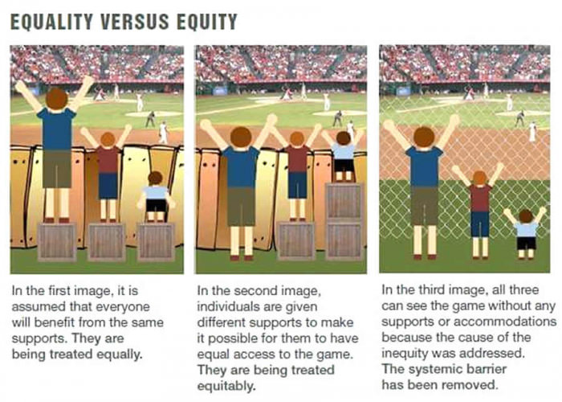

Slide 23
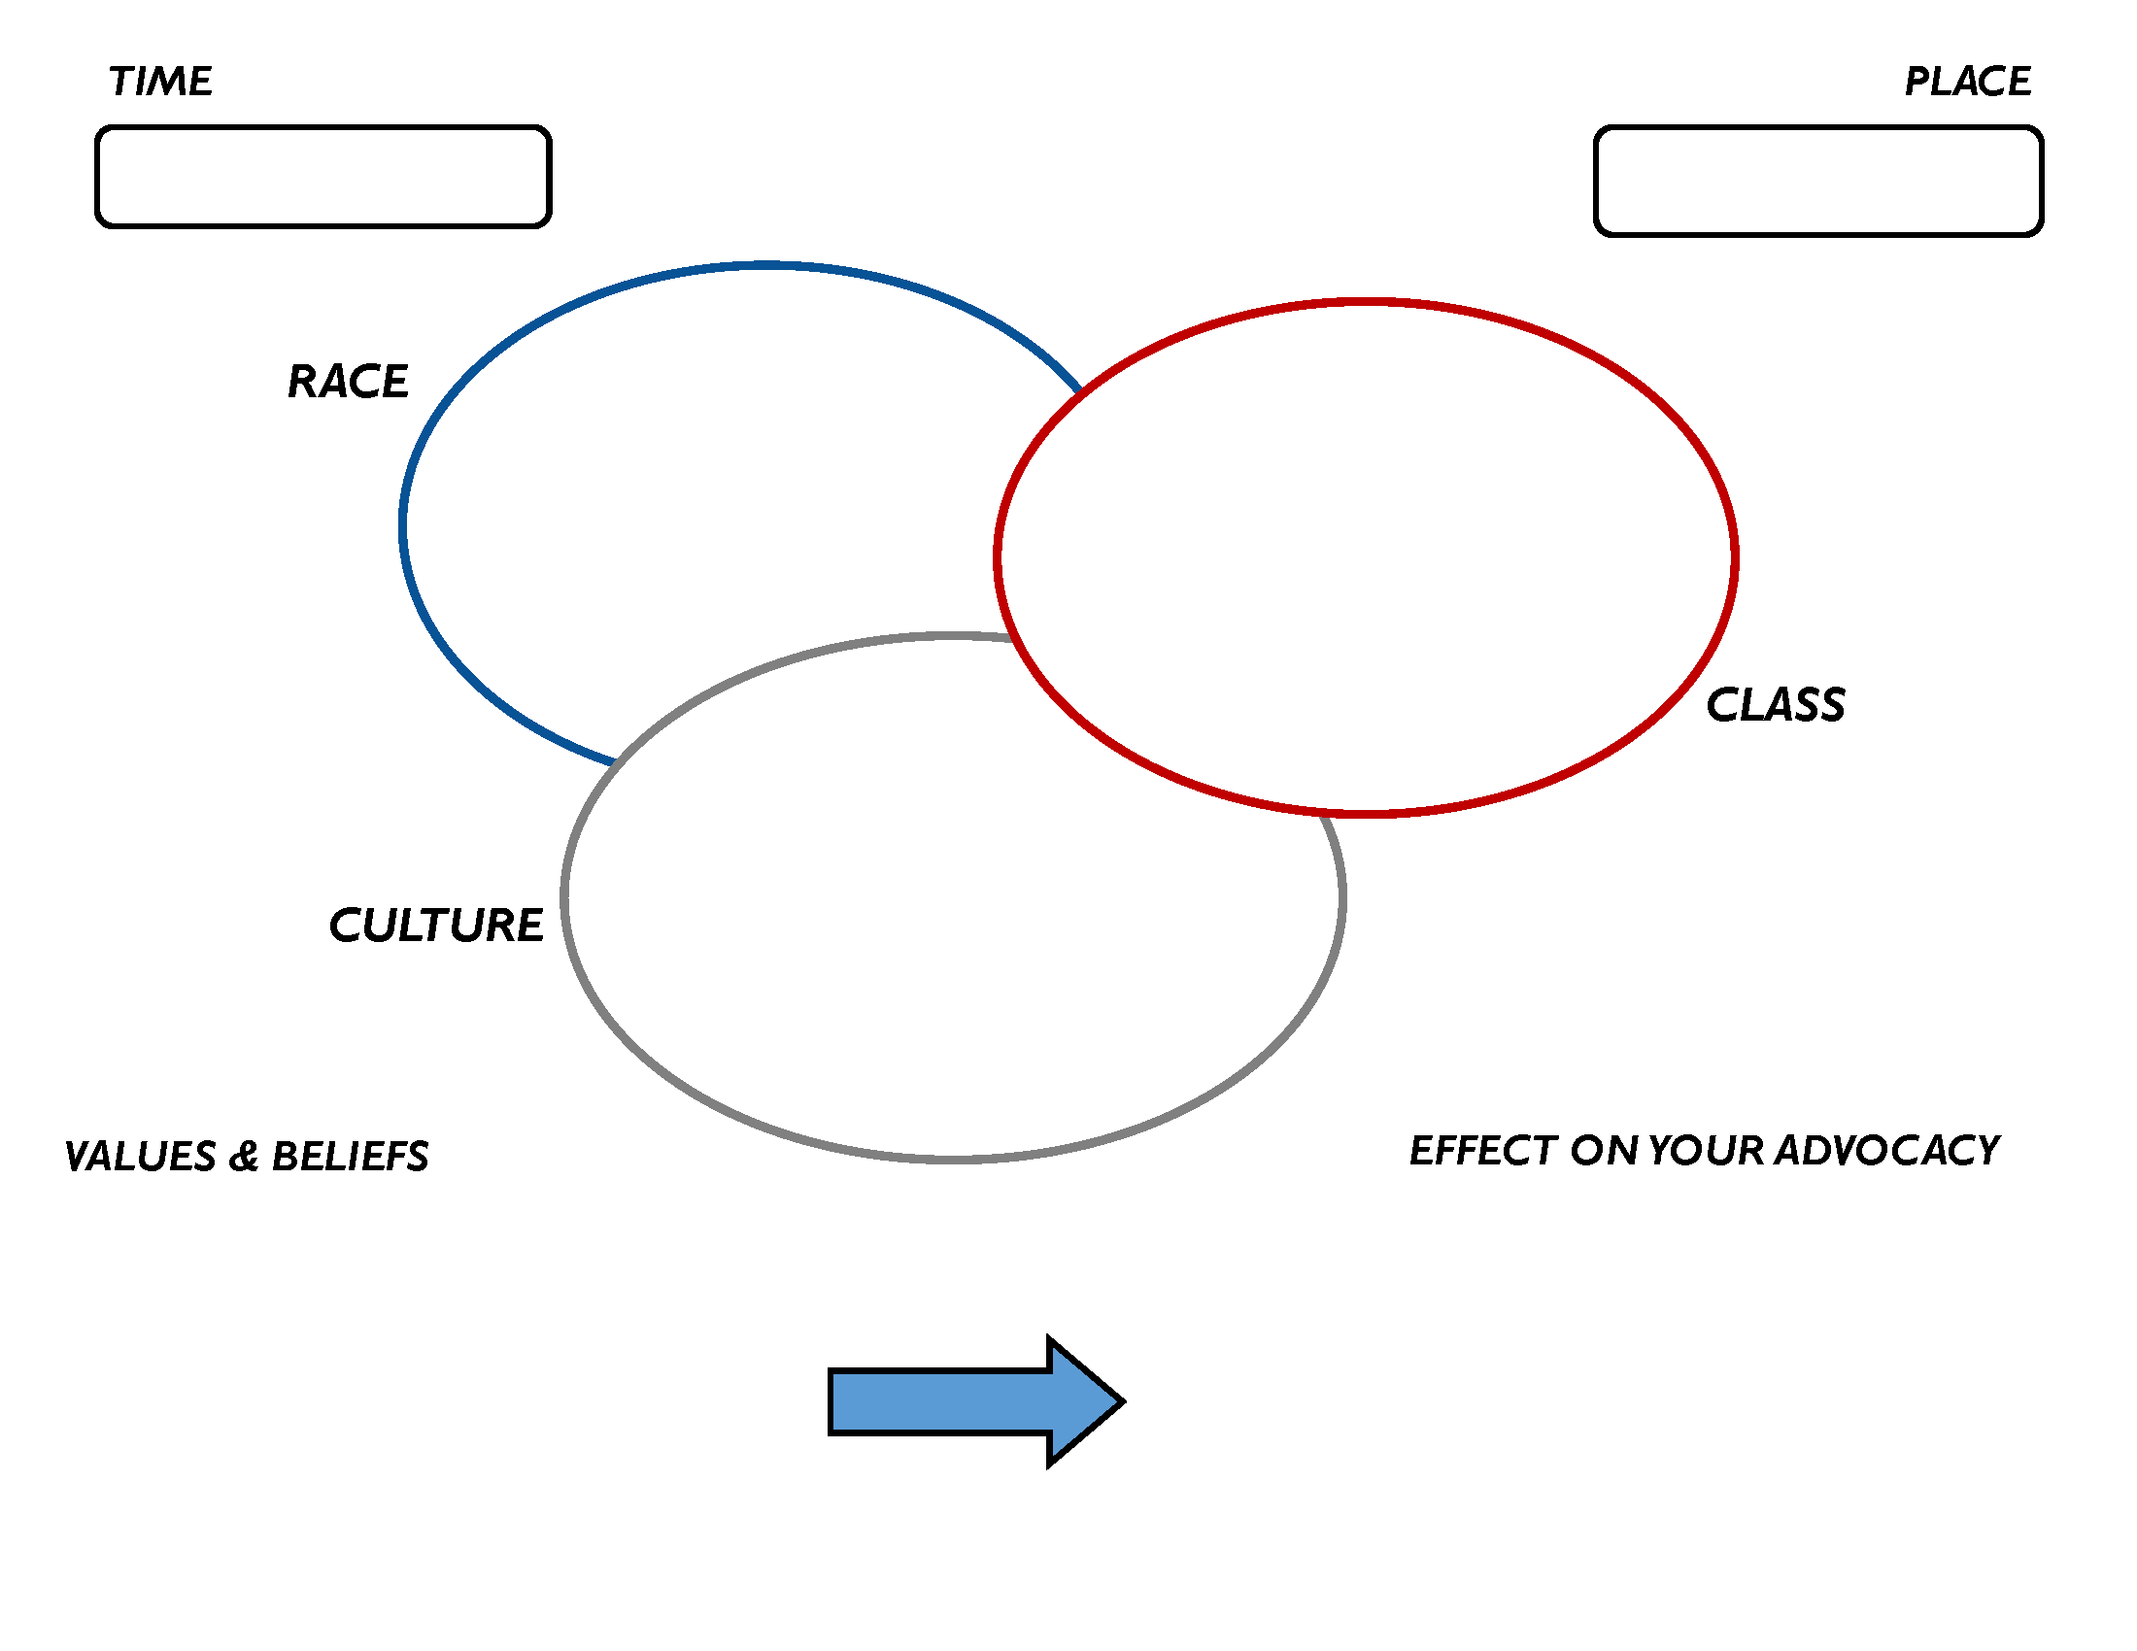
VIDEO DISCUSSION

Slide 24
What YOU can do:
Join VOICES CAN!
Follow us on Social Media
Support our work

